Slide 1



GROW BETTER
KIMIA TEYMOURI NIK
300384851
CSIS 4495-001
Applied Research Project
Winter 2025
Instructor: Padmapriya Arasanipalai Kandhadai

Slide 2
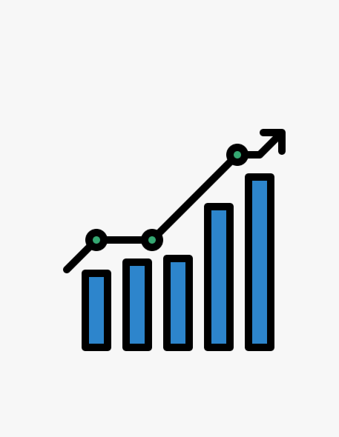
AGENDA
01
02
03
Overview
Novelty and Utility
Technology stack
04
05
06
Key Features Demo
Lessons Learned
Conclusion

Slide 3




OVERVIEW
WHAT IS GROW BETTER?
OBJECTIVES
Grow better is a comprehensive data analytics platform tailored for small business owners in Metro Vancouver cities.
Its primary goal is to help users, especially newcomers or entrepreneurs with limited budgets, make well-informed, data-driven decisions when starting or expanding a business.

Slide 4





KNOWLEDGE GAPS
01
No Centralized Business Data
02
Limited Data From Existing Platforms
03
Lack of Comparative Visual Tools
04
Paywalled Tools Like Yelp

Slide 5
BRIDGING GAPS WITH MODERN TOOLS
Novelty
Unified Experience: data analysis + dashboards, and news.
AI Powered Assistance: offers tailored recommendations.
Live Dashboards: real-time filtering of business types and city names.
User Friendly: designed for non-technical users.
Utility
Helps reduce investment risks
Encourages exploration of emerging cities.
Support business planning with real-time, user-relevant content.

Slide 6


TECHNOLOGY STACK
Backend
Development platform: IntelliJ IDEA
Language: JavaScript (Node.js runtime)
Framework: Express.js
Database: MongoDB
Security: CORS, JSON middleware
Frontend
React.js
Live Dashboards
Python
Streamlit
AI Integration
Ollama (locally hosted LLM)

Slide 7

SYSTEM FRAMEWORK
User Request
User filters data or submits a question (via frontend)
Express routes direct requests to appropriate models or APIs
Route Handler
Database Query
MongoDB is accessed through Mongoose
Ollama fetches user data for intelligent response
AI Query
Frontend Update
Results (business data, AI reply, news) are rendered in real-time

Slide 8

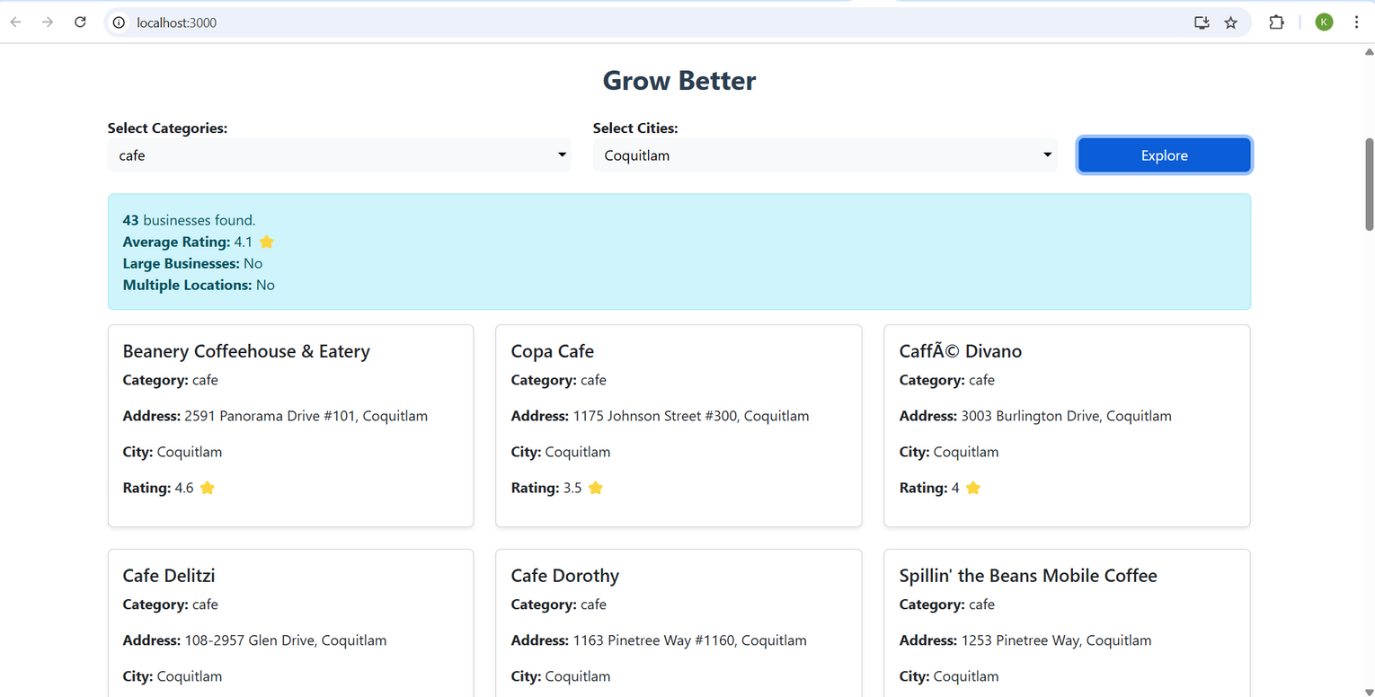
Main Page
The Home Page is the starting point of the Grow Better platform and serves as the primary interface for exploring business data.
Filter business data by city and category (including multi-selection options).
Access detailed business information such as name, address, rating, and category by clicking the "Explore" button.

Slide 9
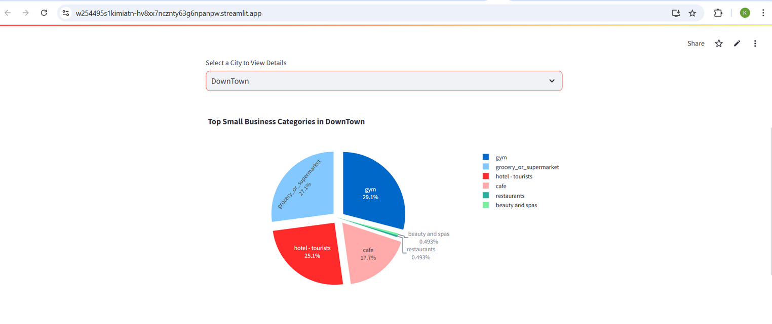
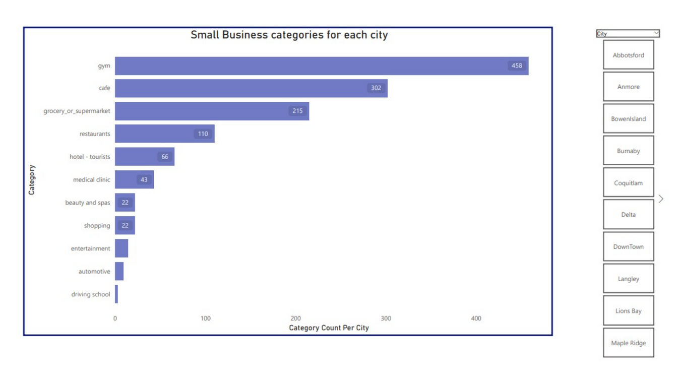
Business Visuals
The Business Visuals section functions as an integrated Business Intelligence (BI) tool, offering rich, insightful visualizations of business trends across Metro Vancouver.
Static and Live dashboards: Live dashboards Developed using Streamlit, allowing interactive filtering and real-time data visualization from MongoDB.

Slide 10
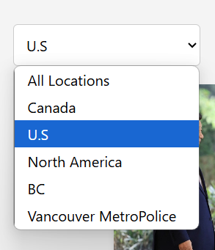
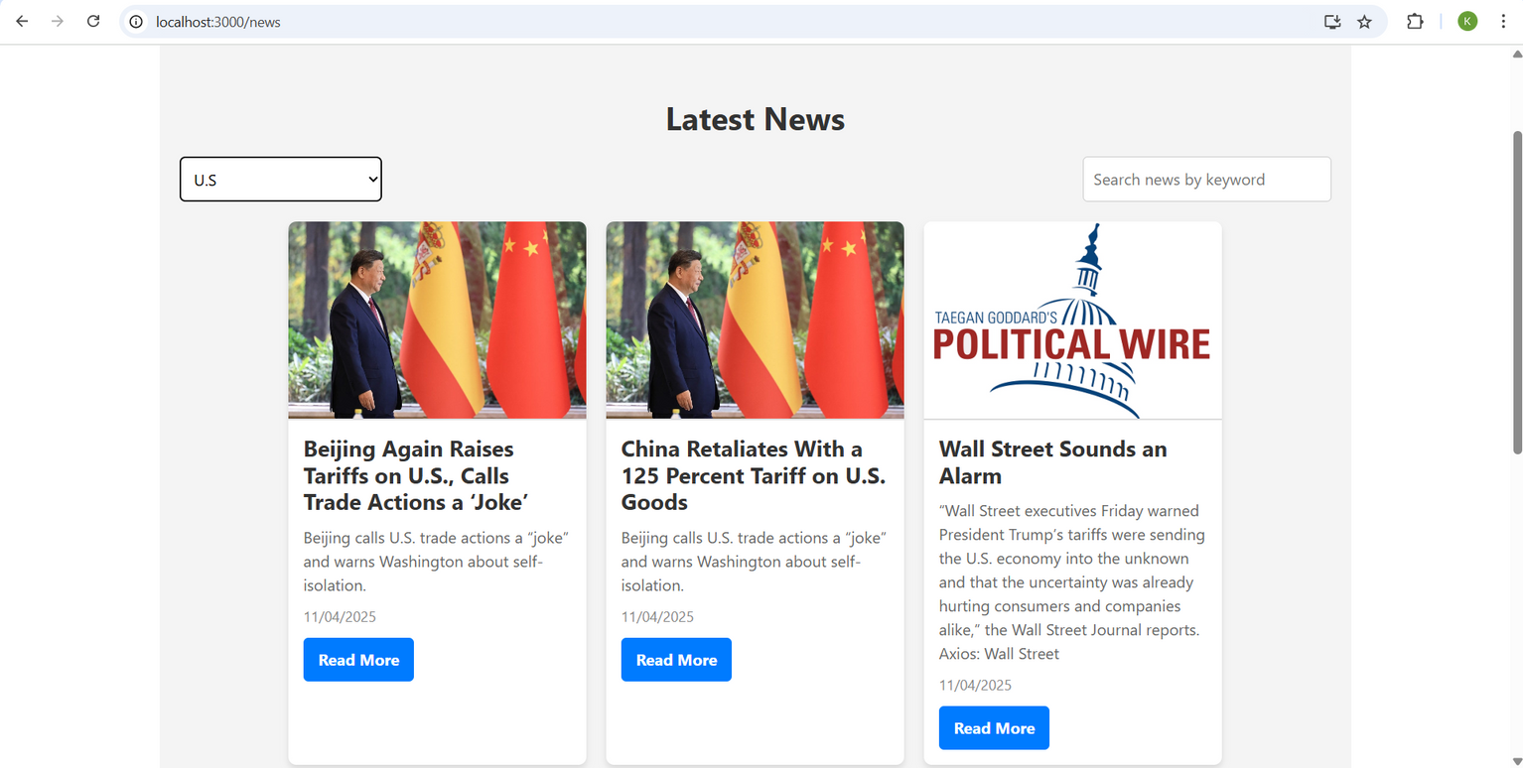
News Section
The News Section provides users with up-to-date, location-specific business news by integrating with the NewsAPI.org.
Fetching live news articles from trusted sources like BBC, Bloomberg, and local Canadian outlets.
Filtering news content by region or keywords relevant to small businesses in Metro Vancouver.
\

Slide 11
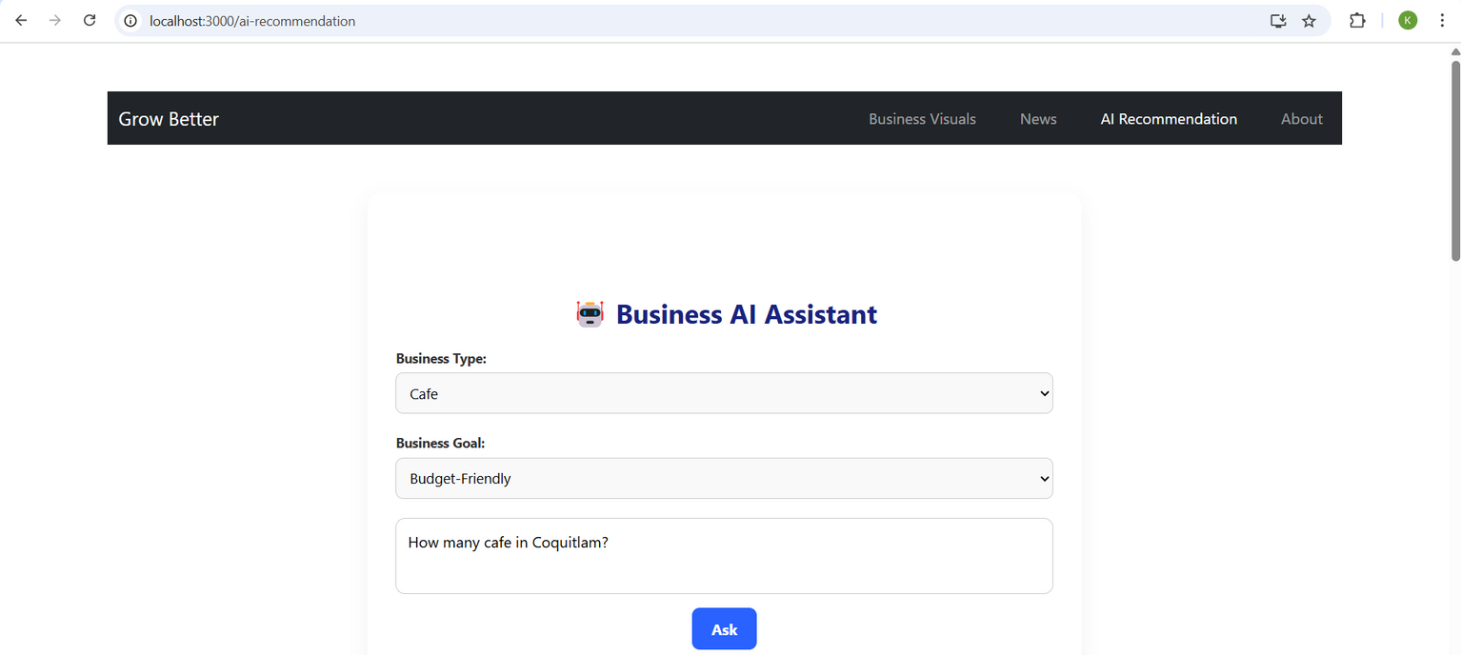
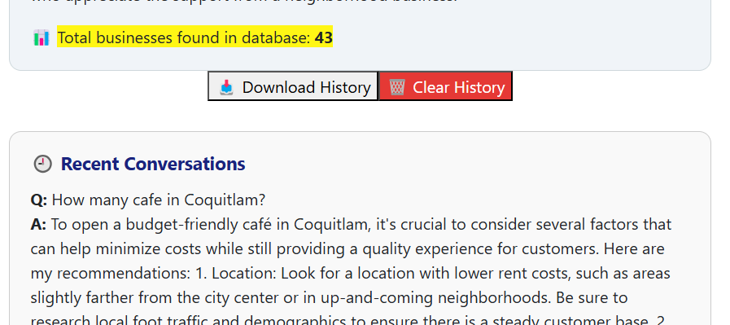
AI Suggestions
This feature integrates an AI-powered assistant using the locally hosted Ollama LLM to provide personalized insights and strategic recommendations.
Ask questions like “What is the best location for a bakery in Burnaby?”
Get intelligent responses based on data pulled from MongoDB.
Save and review chat history, or download it as a PDF.

Slide 12


LESSONS LEARNED
New Technical Learnings
Soft Skills Development
Implementing live dashboards by Streamlit.
AI Integration with Ollama
Practical understanding of tools
Communication and Reporting skills.
Adaptability & Creative Problem-Solving.
Time Management: balancing course load & documentation.
Management Skills
Strategic Project Management: Learned to break large tasks into manageable phases, helping with organization and clarity throughout the development.

Slide 13




CONCLUSION
Real-world tech applied
Strongest Learning Areas
Future Development
Full stack development and user-centered design.
My First Experience applying the most recent technologies.
Guidance on free business support tools.

Slide 14



THANK YOU & LIVE DEMO INVITATION
Kimia Nik
Product owner of Grow Better
Presentation designed using Canva for visual clarity and consistency.

